Slide 1
Chapter 5: Counting

Slide 2
Why counting?

Slide 3
Introduction
We will be using two basic counting principles to solve a few combinatorial word problems.
The addition principle
The multiplication principle

Slide 4
The Addition Principle

Slide 5
A Visualization of the Addition Principle
How many ways are there to
choose 1 object?
Choose from 3 red,
2 green,
and 4 blue.

Slide 6
The Multiplication Principle

Slide 7
A Visualization of the Multiplication Principle
How many ways are there to
choose 1 shape of each color?
First stage:
3 possible
outcomes
Second stage:
3 possible
outcomes
Third stage:
3 possible
outcomes

Slide 8
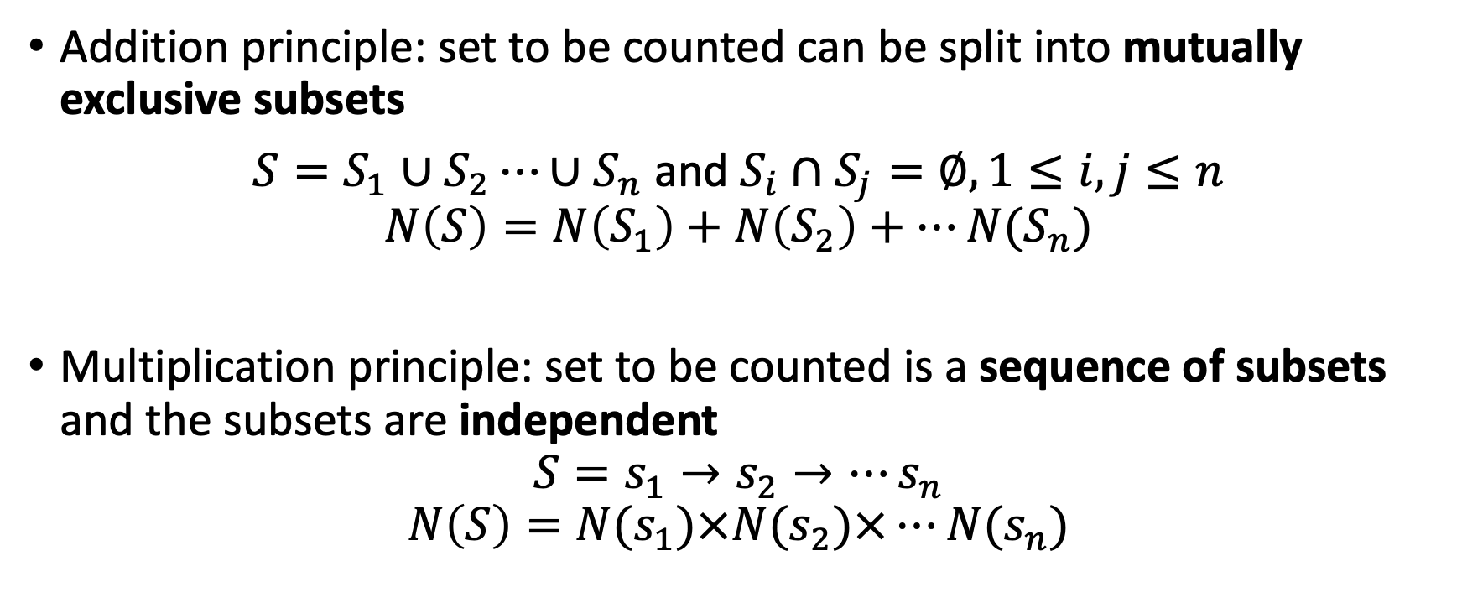
The condition to use two principles
Addition principle: set to be counted can be split into mutually exclusive subsets
$S=S_{1}∪S_{2}⋯{∪S}_{n}$ and $S_{i}∩S_{j}=∅, 1≤i,j≤n$
$$N\left(S\right)=N\left(S_{1}\right)+N\left(S_{2}\right)+⋯N(S_{n})$$
Multiplication principle: set to be counted is a sequence of subsets and the subsets are independent
$$S=s_{1}→s_{2}→⋯s_{n}$$
$$N\left(S\right)=N(s_{1})×N(s_{2})×⋯N(s_{n})$$

Slide 9
Example 1: Adding Sets of Students
A professor has 40 students in his algebra class from computer science major and 40 students from applied math major. How
many different students are in his algebra classes?
No student can have two different majors, the two subsets are mutually exclusive, therefore we can use addition principle.
The answer is obvious: 40+40=80.

Slide 10
Example 2
A professor’s algebra course has 40 student, and geometry course has 40 students, how many students he is teaching?

Slide 11
Analysis: student who take algebra may also take geometry, the two subsets are NOT exclusive.
Now suppose 10 students are in both classes.
To obtain disjoint sets, we categorize the students as follows:
Just in algebra
Just in geometry
In both classes
30
10
30
Since 10 students are in both classes, there are
40 – 10 = 30 students in just algebra and 30 in just
geometry.
The total number of students is then
30 + 30 + 10 = 70.

Slide 12
Example 3: Rolling Dice
Note:
“Independent”
means that what we roll
on the first die does not
influence what we roll
on the second.

Slide 13
Example 3 (continued)
Recall:
desired outcomes
total outcomes
Probability =

Slide 14
Example 4: Arranging Books
There are 5 different Spanish books,
6 different French books,
8 different Transylvanian books.
How many different ways are there to pick an (unordered) pair of two books not in the same language?

Slide 15
Example 4 (continued)
There are 3 types of selections, each of which requires successive selections; use the Multiplication Principle:
1 Spanish and 1 French 5 6 = 30
1 Spanish and 1 Transylvanian 5 8 = 40
1 French and 1 Transylvanian 6 8 = 48
These 3 types of selections are disjoint, so now use the Addition Principle:
30 + 40 + 48 = 118.

Slide 16
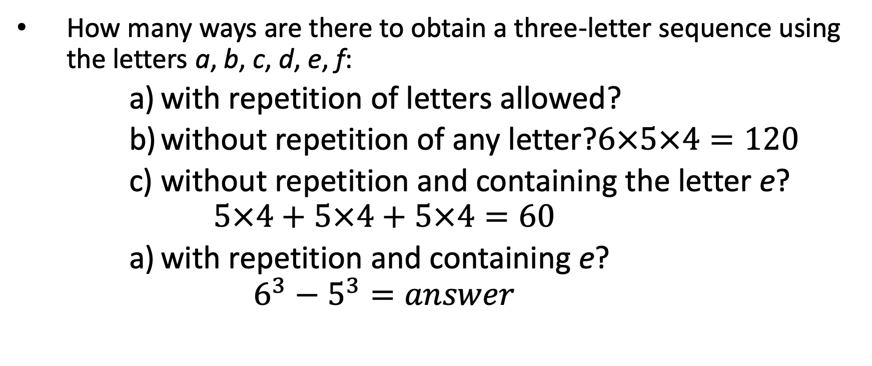
Example 5: Sequences of Letters
How many ways are there to obtain a three-letter sequence using the letters a, b, c, d, e, f:
with repetition of letters allowed?
without repetition of any letter?$6×5×4=120$
without repetition and containing the letter e?
$$5×4+5×4+5×4=60$$
with repetition and containing e?
$$6^{3}−5^{3}=answer$$

Slide 17
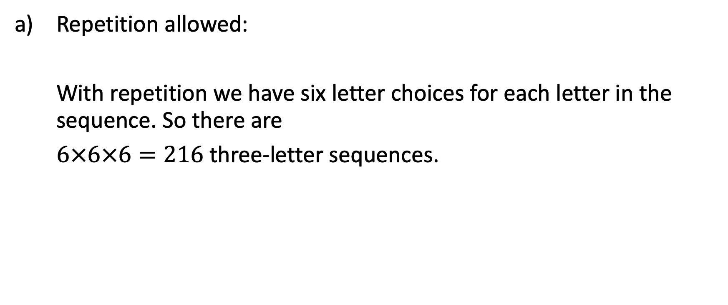
Example 5 (continued)
Repetition allowed:
With repetition we have six letter choices for each letter in the sequence. So there are
$6×6×6=216$ three-letter sequences.

Slide 18
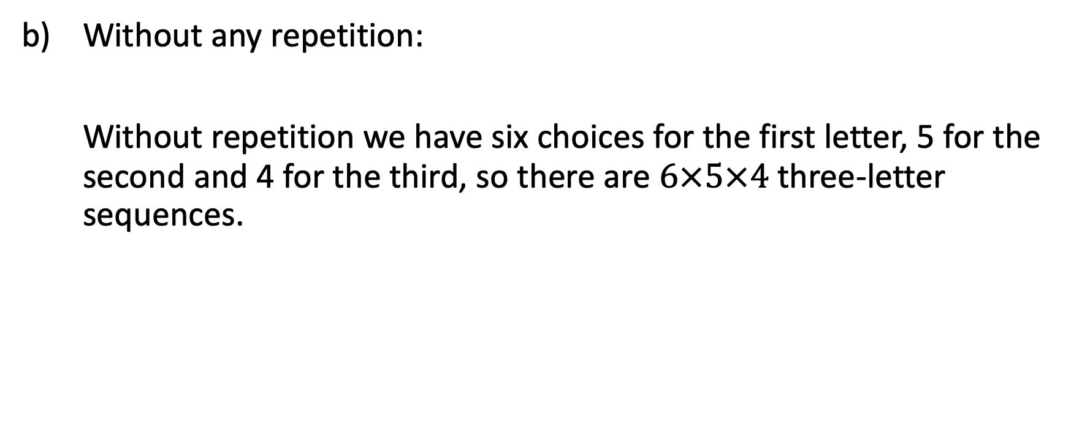
Example 5 (continued)
Without any repetition:
Without repetition we have six choices for the first letter, 5 for the second and 4 for the third, so there are $6×5×4$ three-letter sequences.

Slide 19
Example 5 (continued)
Without repetition and containing the letter e:
It can be helpful to make a diagram showing the positions in a sequence.
Since the sequence must contain e, there are three choices for which position in the sequence is e, as is shown in the following three diagrams:
e
e
e

Slide 20
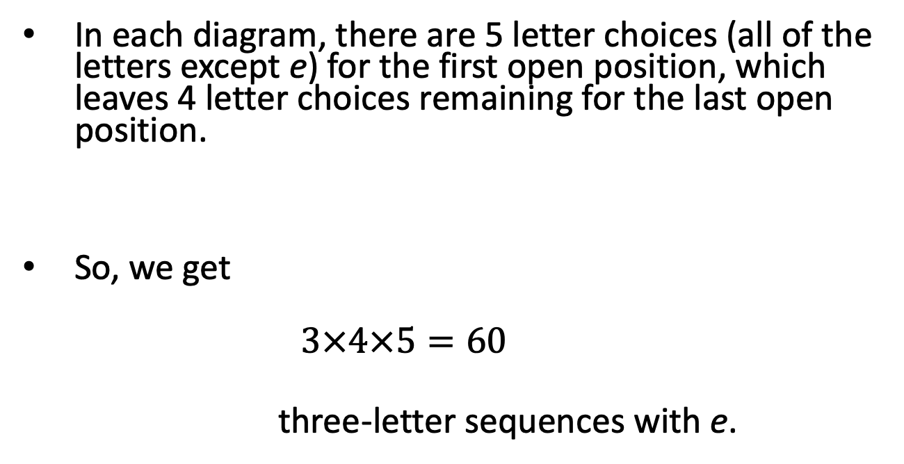
Example 4 (continued)
In each diagram, there are 5 letter choices (all of the letters except e) for the first open position, which leaves 4 letter choices remaining for the last open position.
So, we get
$$3×4×5=60$$
three-letter sequences with e.
e
e
e

Slide 21
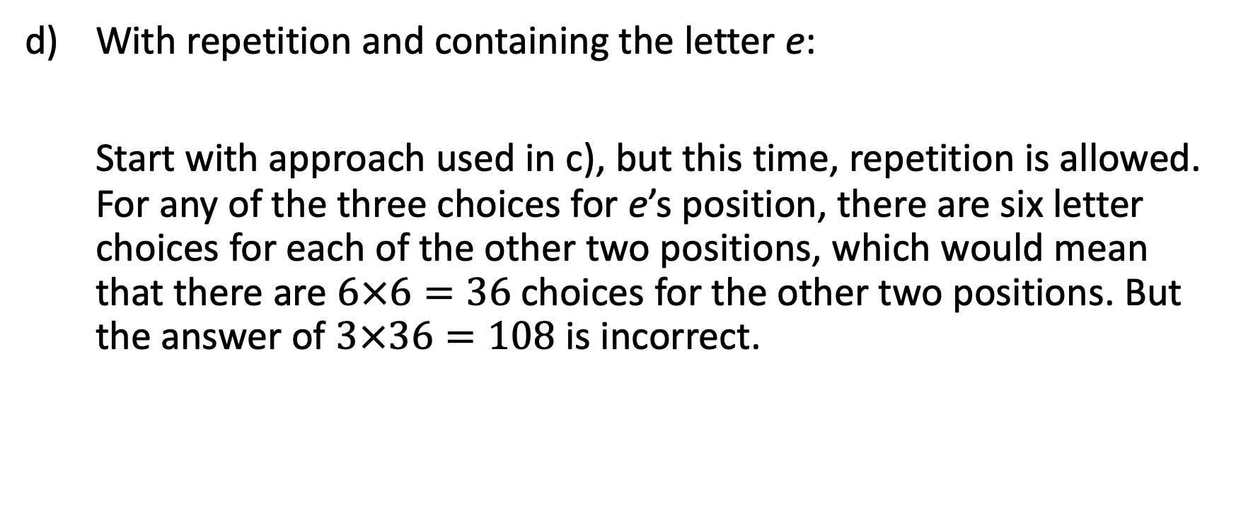
Example 4 (continued)
With repetition and containing the letter e:
Start with approach used in c), but this time, repetition is allowed. For any of the three choices for e’s position, there are six letter choices for each of the other two positions, which would mean that there are $6×6=36$ choices for the other two positions. But the answer of $3×36=108$ is incorrect.

Slide 22
Example 5 (continued)
The problem is that some sequences were counted more than once using the previous method. Consider this sequence:
It was generated twice using our previous method: once when e was put in the first position and followed by ce as one of the 36 choices for the latter two positions, and once when e was put in the third position with ec in the first two positions.
e
c
e

Slide 23
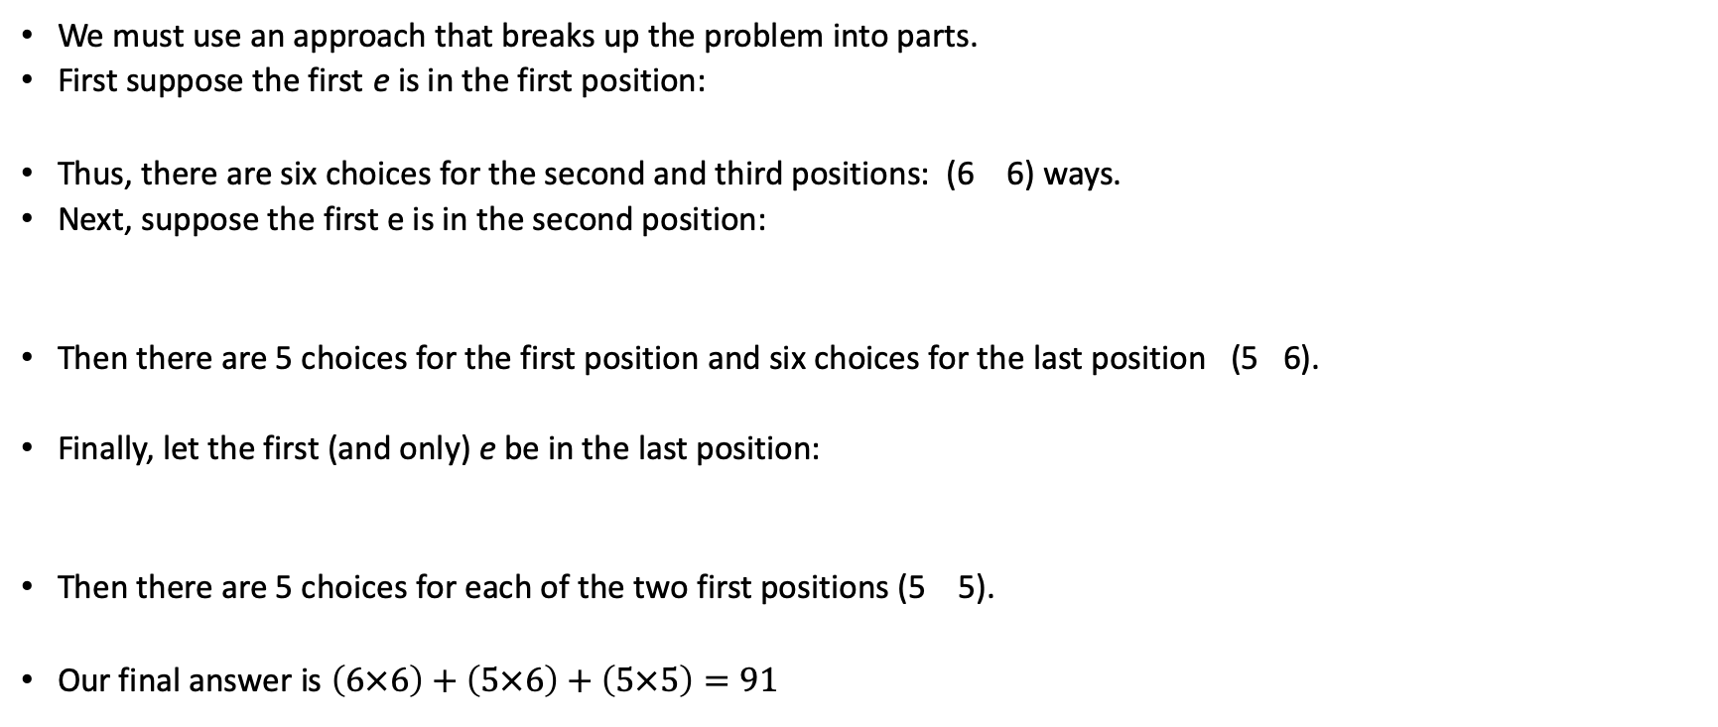
Example 5 (continued)
We must use an approach that breaks up the problem into parts.
First suppose the first e is in the first position:
Thus, there are six choices for the second and third positions: (6 6) ways.
Next, suppose the first e is in the second position:
Then there are 5 choices for the first position and six choices for the last position (5 6).
Finally, let the first (and only) e be in the last position:
Then there are 5 choices for each of the two first positions (5 5).
Our final answer is $\left(6×6\right)+\left(5×6\right)+\left(5×5\right)=91$
e
e
no e
e
no e
no e

Slide 24
Example 6: Nonempty Collections
How many nonempty different collections can
formed from five (identical) apples and eight
(identical) grapefruits?

Slide 25
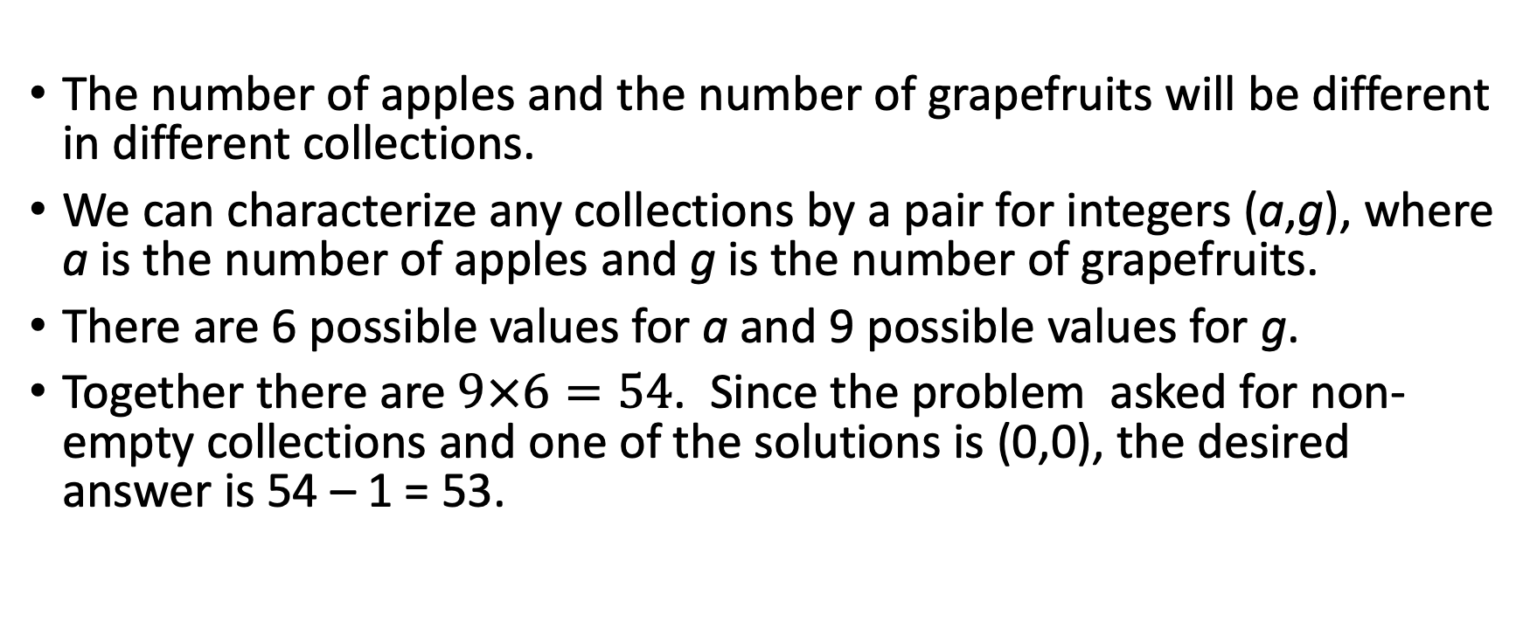
Example 6 (continued)
The number of apples and the number of grapefruits will be different in different collections.
We can characterize any collections by a pair for integers (a,g), where a is the number of apples and g is the number of grapefruits.
There are 6 possible values for a and 9 possible values for g.
Together there are $9×6=54$. Since the problem asked for non-empty collections and one of the solutions is (0,0), the desired answer is 54 – 1 = 53.

Slide 26
Advice
Try writing down in a systematic way some of the possible outcomes you want to enumerate.
Think of your list as part of a particular subcase.
Ask yourself how many outcomes would your list need to complete that subcase.
Figure out what other subcases need to be counted.

Slide 27
Summary
We must find a way to recast the constraints on the problem so that some combination of the addition and multiplication principles can be applied.
To use these principles, we must break the problem into pieces or stages, and be sure that the outcomes in the different pieces are distinct.

Slide 28
Class quiz problem 1:
How many ways are there to pick a man and a woman who are not husband and wife from a group of n married couples?

Slide 29
Class quiz problem 2:
Diane packed 2 skirts, 4 blouses, and a sweater for her business trip. She will need to choose a skirt and a blouse for each outfit and decide whether to wear the sweater. Use the Multiplication Principle to find the total number of possible outfits.

Slide 30
Simple Arrangements and Selections

Slide 31
Definitions
Total Permutation of n distinct objects is an arrangement, or ordering, of the n objects.
N choose r-Permutation of n distinct objects is an arrangement using r of the n objects. We use P (n, r) to denote the number of r-permutations of a set of n objects.
N choose r-Combination of n distinct objects is an unordered selection, or subset, of r out of the n objects. We use C (n, r) to denote the number of r-combinations of a set of n objects.

Slide 33
Total permutation, also the n choose n permutation: $P\left(n,n\right)=n!$

Slide 34

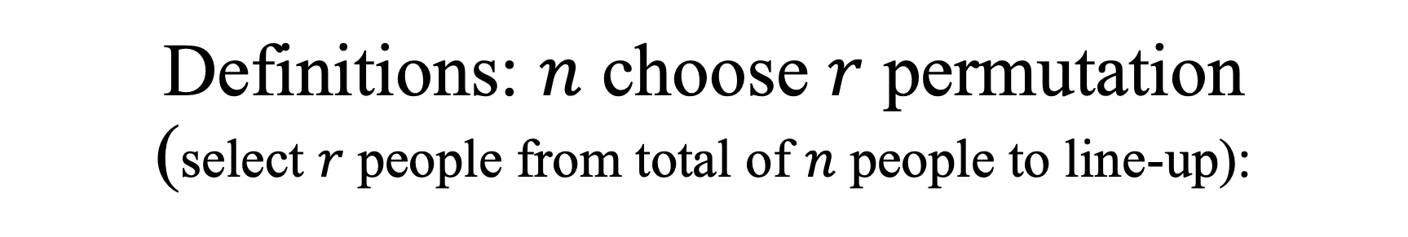
Definitions: $n$ choose $r$ permutation (select $r$ people from total of $n$ people to line-up):
From the multiplication principle we obtain.
$P\left(n,2\right)=n(n−1)$,
$P\left(n,3\right)=n(n−1)(n−2)$,
$⋯$
$P\left(n,r\right)=n(n−1)(n−2)⋯(n−r+1)$
$⋯$
$P\left(n,n\right)=n\left(n−1\right)\left(n−2\right)⋯×3×2×1=n!$

Slide 35
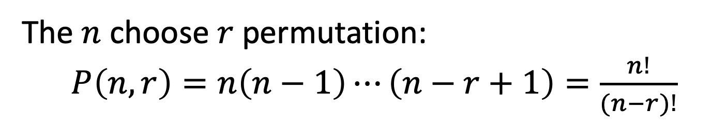
The $n$ choose $r$ permutation:
$P\left(n,r\right)=n\left(n−1\right)⋯\left(n−r+1\right)=\frac{n!}{(n−r)!}$

Slide 36
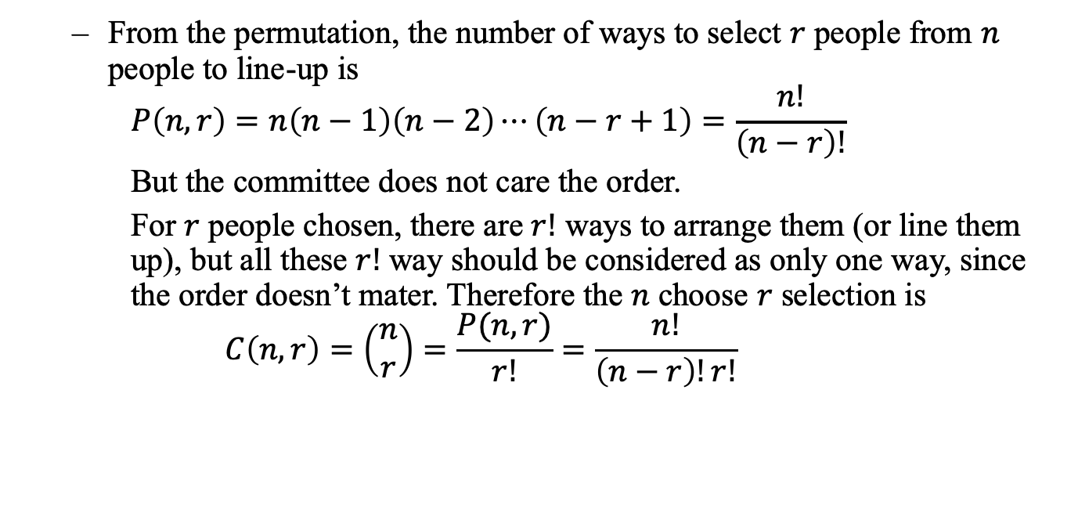
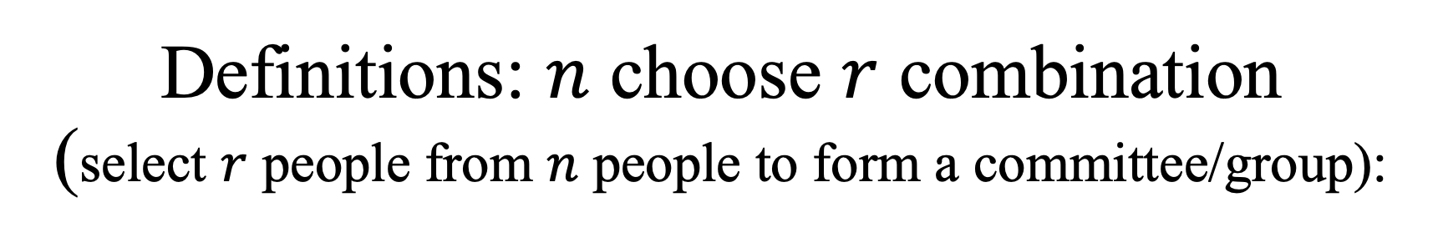
Definitions: $n$ choose $r$ combination (select $r$ people from $n$ people to form a committee/group):
From the permutation, the number of ways to select $r$ people from $n$ people to line-up is
$$P\left(n,r\right)=n\left(n−1\right)\left(n−2\right)⋯\left(n−r+1\right)=\frac{n!}{\left(n−r\right)!}$$
But the committee does not care the order.
For $r$ people chosen, there are $r!$ ways to arrange them (or line them up), but all these $r!$ way should be considered as only one way, since the order doesn’t mater. Therefore the $n$ choose $r$ selection is
$$C\left(n,r\right)=\left(\begin{matrix}n \\ r\end{matrix}\right)=\frac{P(n,r)}{r!}=\frac{n!}{\left(n−r\right)!r!}$$

Slide 38
Example 1 – Arrangements with Repeated Letters
In the word SYSTEMS how many ways can you arrange the letters so that all three S’s appear consecutively?
What is the probability for putting such a string randomly.
First, we must find all possible ways for putting these seven letters. We have seven positions, for each of these non-S letters, the number of ways to occupying these positions are
P(7,4) = 7!/3! = 840 different ways.
And then there is one way to put the three S’s.

Slide 39
Example 1 continued:
Next, we consider three S’s consecutively. The “trick” to do this is to group the S’s as one letter. So the possible letters are E, M, T, Y, and SSS. These 5 letters can be grouped in 5!, or 120, ways.
The probability is then:

Slide 40
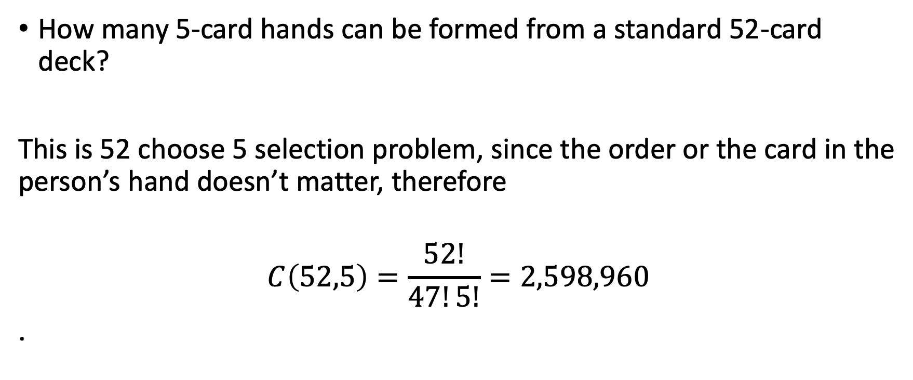
Example 2 – Poker Probabilities
How many 5-card hands can be formed from a standard 52-card deck?
This is 52 choose 5 selection problem, since the order or the card in the person’s hand doesn’t matter, therefore
$$C\left(52,5\right)=\frac{52!}{47!5!}=2,598,960$$
.

Slide 41
Example 2 cont’d
What is the probability that a random 5-card hand from a standard deck will result in a flush (all cards of the same suit)?
First, find all subsets of 5-cards within the same suit: C(13,5) = 13! / (5!8!) = 1287 possible flushes for one suit.
Multiply that result by 4 (for the 4 suits in a deck): 1287 x 4 = 5148 possible flushes.

Slide 42
Example 2 cont’d
To find the probability of getting a flush randomly, take the number of possible flushes and divide by the total number of possible hands: 5148 / 2,598,960 = 0.00198, or roughly 0.2%

Slide 43
Example 2 cont’d
What is the probability of getting 3, but not 4, aces in a 5-card hand?
First, you must pick 3 of the four aces, done in C(4,3) = 4 ways.
Next, fill your hand with any 2 of the 48 other cards in the deck: C(48,2) = 1128 ways.
Multiply the results to get 1128 x 4 = 4512 ways you can get 3 aces.

Slide 44
Example 2 cont’d
To find the probability, divide by the total number of possible hands: 4512 / 2,598,960 = 0.00174, or roughly 0.17%

Slide 45
Example 3 – Forming Committees
A committee of k people is to be chosen from a set of 7 women and 4 men. How many ways can you form a committee if:
The committee consists of 3 women and 2 men?
The committee consists of 4 people, and Mr. Baggins must be on it?

Slide 46
Example 3 cont’d
In case 1, you must simply pick between two subsets, men and women. Since there are three women and 2 men, the numbers are as follows:
C(7,3) x C(4,2) = 35 x 6 = 210 different ways

Slide 47
Example 3 cont’d
In case 2, Mr. Baggins forced entry into the committee lessens our choices for who else is on the committee. But since there were no other restrictions (no gender restrictions), we can simply choose 3 from the remaining 10: C(10,3) = 120
An easy mistake to make is to assume gender restrictions; read the problems carefully

Slide 48
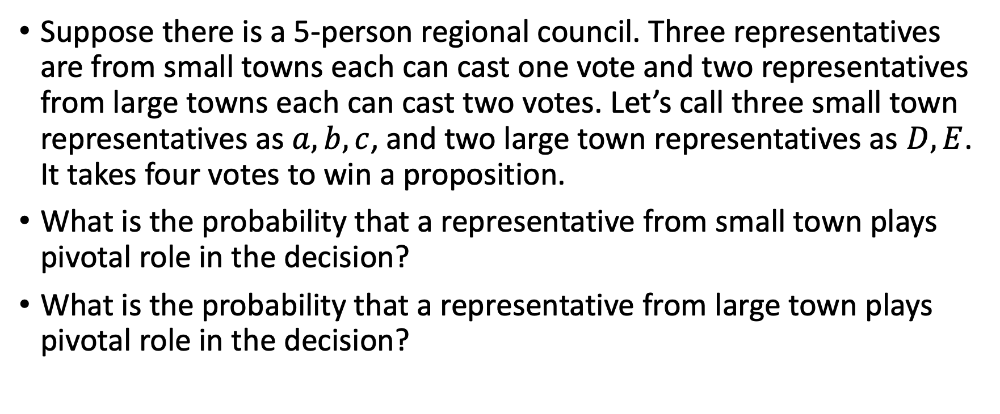
Example 4: voter power
Suppose there is a 5-person regional council. Three representatives are from small towns each can cast one vote and two representatives from large towns each can cast two votes. Let’s call three small town representatives as $a, b, c$, and two large town representatives as $D,E$. It takes four votes to win a proposition.
What is the probability that a representative from small town plays pivotal role in the decision?
What is the probability that a representative from large town plays pivotal role in the decision?

Slide 49
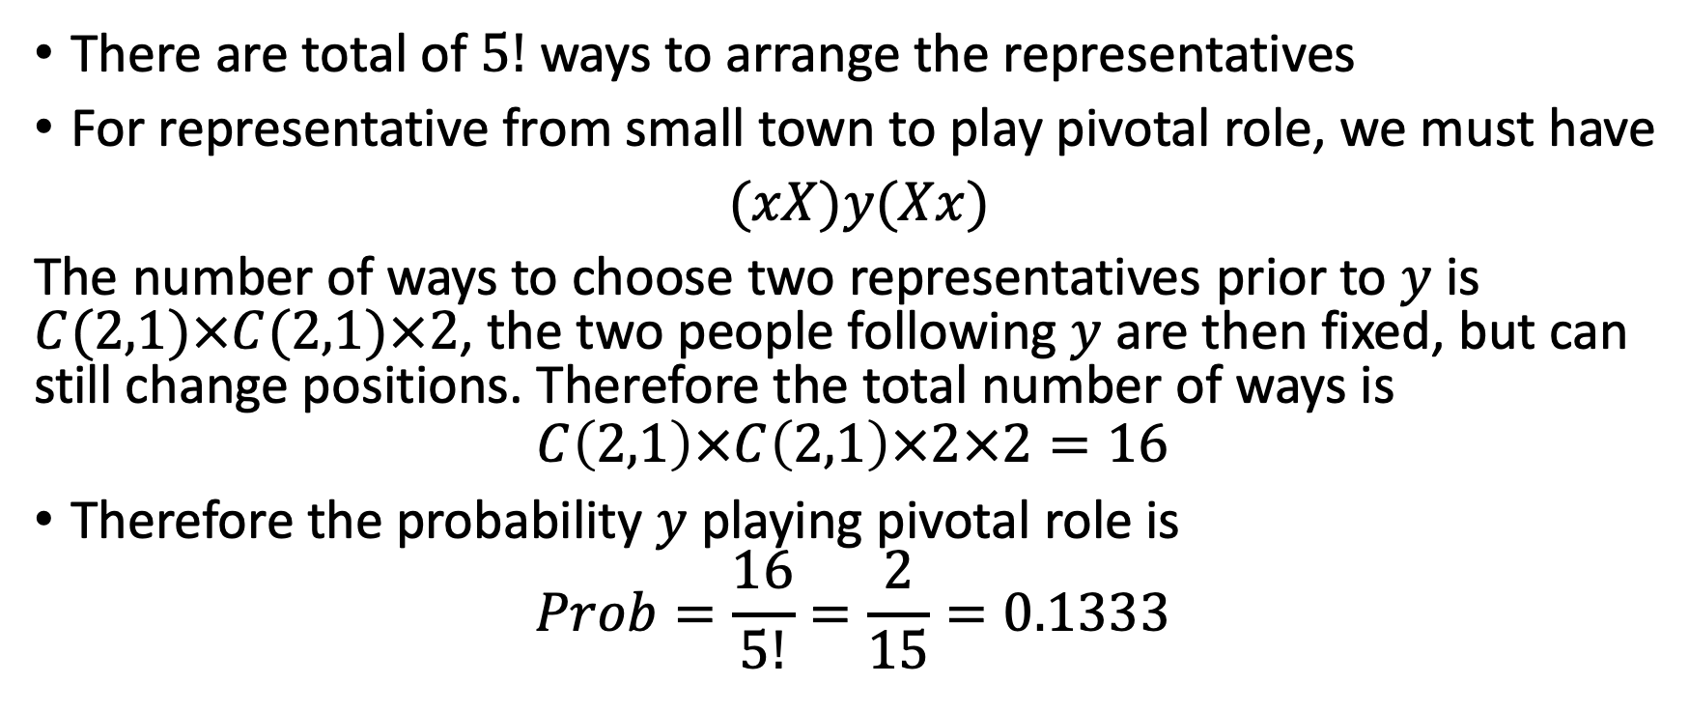
Example 4 continued:
There are total of $5!$ ways to arrange the representatives
For representative from small town to play pivotal role, we must have
$(xX)y(Xx)$
The number of ways to choose two representatives prior to $y$ is $C(2,1)×C(2,1)×2$, the two people following $y$ are then fixed, but can still change positions. Therefore the total number of ways is
$$C\left(2,1\right)×C\left(2,1\right)×2×2=16$$
Therefore the probability $y$ playing pivotal role is
$$Prob=\frac{16}{5!}=\frac{2}{15}=0.1333$$

Slide 50
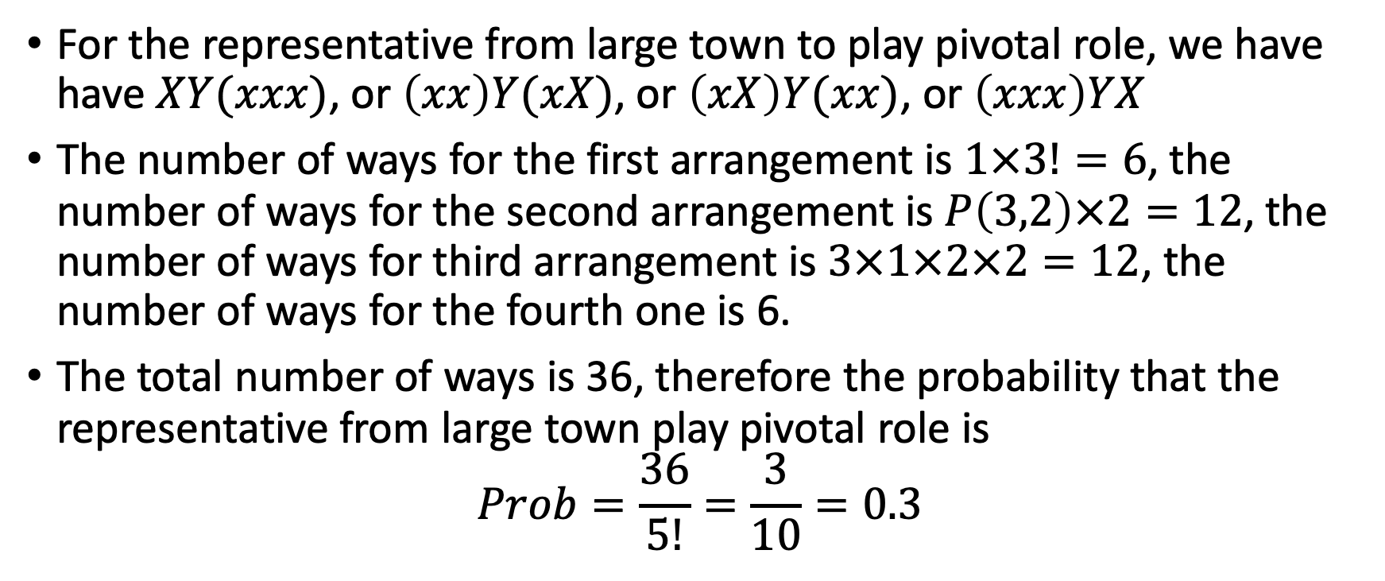
Example 4 continued:
For the representative from large town to play pivotal role, we have have $XY(xxx)$, or $\left(xx\right)Y(xX)$, or $\left(xX\right)Y(xx)$, or $\left(xxx\right)YX$
The number of ways for the first arrangement is $1×3!=6$, the number of ways for the second arrangement is $P\left(3,2\right)×2=12$, the number of ways for third arrangement is $3×1×2×2=12$, the number of ways for the fourth one is 6.
The total number of ways is 36, therefore the probability that the representative from large town play pivotal role is
$$Prob=\frac{36}{5!}=\frac{3}{10}=0.3$$

Slide 51
The probability that an entity plays the pivotal role in an election is called the Shapley-Shibik Index

Slide 52
Theorem 1
If there are n objects with r₁ of type 1, r₂ of type 2, …, and r_{m} of type m, where r₁+r₂+…+r_{m}= n, then the number of arrangements of these n objects denoted P(n; r₁,r₂,…,r_{m}) is:

Slide 53
Example/Proof
How many ways are there to arrange the six letters: B-A-N-A-N-A ?
Six places: _ _ _ _ _ _
A _ _ A _ A
Places to put the A’s
A _ N A N A
Places to put the N’s
A B N A N A
Places to put the B

Slide 54
Example/Proof cont’d
Total =
(2)
Combinations

Slide 55
Alternate Proof
Suppose we add subscripts to each of the r_{i} objects of type i to make each object distinct.
Then there are n! ways to arrange the n distinct objects.
We can account for each of these arrangements by switching the subscripts around in each type of object, as follows with the “banana example”.
ba₁a₂nna₃ ba₂a₁nna₃ ba₃a₁nna₂
ba₃a₂nna₁ ba₁a₃nna₂ ba₂a₃nna₁

Slide 56
Alternate Proof cont’d
ba₁a₂nna₃ ba₂a₁nna₃ ba₃a₁nna₂
ba₃a₂nna₁ ba₁a₃nna₂ ba₂a₃nna₁
In this example, there are 3! ways to rearrange the a’s and one will notice that there are 2! ways to rearrange the n’s in each of these arrangements.
In general, there are r₁!r₂! . . . r_{m}! arrangements for a group of m types. This gives us:
n!=P(n;r₁, r₂, . . . r_{m}) r₁!r₂! . . . r_{m}!
P(n;r₁, r₂, . . . r_{m})=n!/(r₁!r₂! . . . r_{m}!)

Slide 57
Example 2
This example deals with arrangements with restricted positions.
How many ways are there to arrange the letters in B-A-N-A-N-A such that the B is always immediately followed by an A?

Slide 58
Solution
This amounts to sticking the B and an A together as if they were one letter and finding the number of ways to arrange the five objects: BA, A, A, N, N.
Using Theorem 1 this gives us P(5; 2, 2, 1)
= 5!/(1!2!2!) = 30 Arrangements

Slide 59
Theorem 2
Selections-With-Repetition
The number of selections with repetition of r objects, chosen from n types of objects is:
C(r + n –1, r).

Slide 60
Example/Proof
How many ways are there to fill a box with a dozen doughnuts chosen from five different varieties with the requirement that at least one doughnut of each variety is picked?
First you would pick one doughnut of each variety to meet the requirement and then pick the seven remaining doughnuts anyway you please.
Using Theorem 2 : C(r + n –1, r)
Where r is the number of objects picked in any order
n is the different types of objects
We get: C(7 + 5 –1, 7) = 330 ways to pick a dozen doughnuts

Slide 61
Example/Proof cont’d
Had the requirement been that we need at least two of each type of doughnut, we would have picked two of each variety and then picked the remaining two however we pleased.
Then we get: C(2 + 5 –1, 2) = 15 ways to pick a dozen doughnuts
With this requirement we can easily see that this theorem works, since there are 15 combinations of 2 objects if we are selecting the objects from 5 different types (count them!)

Slide 62
Example 4
How many different ways are there to select six hot dogs from three different hot dog types?

Slide 63
Solution
Suppose the three types are chili dogs, foot-longs, and regular hot dogs.
We can show how many of each we choose with the following notation:
Foot-Long Chili Regular
x x | x x | x x
By placing two vertical lines between the hot dogs (each represented by the letter x) we can say that the hot dogs between the lines are chili dogs, those to the left of both lines are foot-longs, and those to the right of both lines are regular hot dogs.

Slide 64
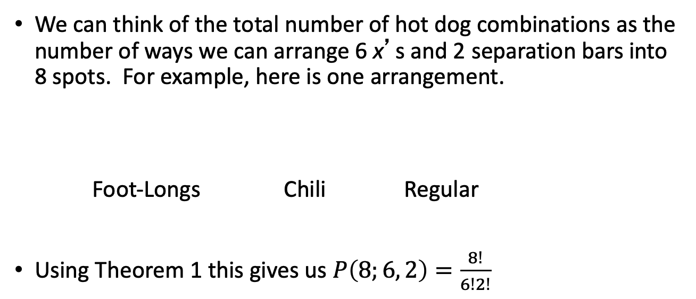
Solution cont’d
We can think of the total number of hot dog combinations as the number of ways we can arrange 6 x’s and 2 separation bars into 8 spots. For example, here is one arrangement.
Foot-Longs Chili Regular
Using Theorem 1 this gives us $P\left(8;6, 2\right)=\frac{8!}{6!2!}$
x x | x x x | x

Slide 65
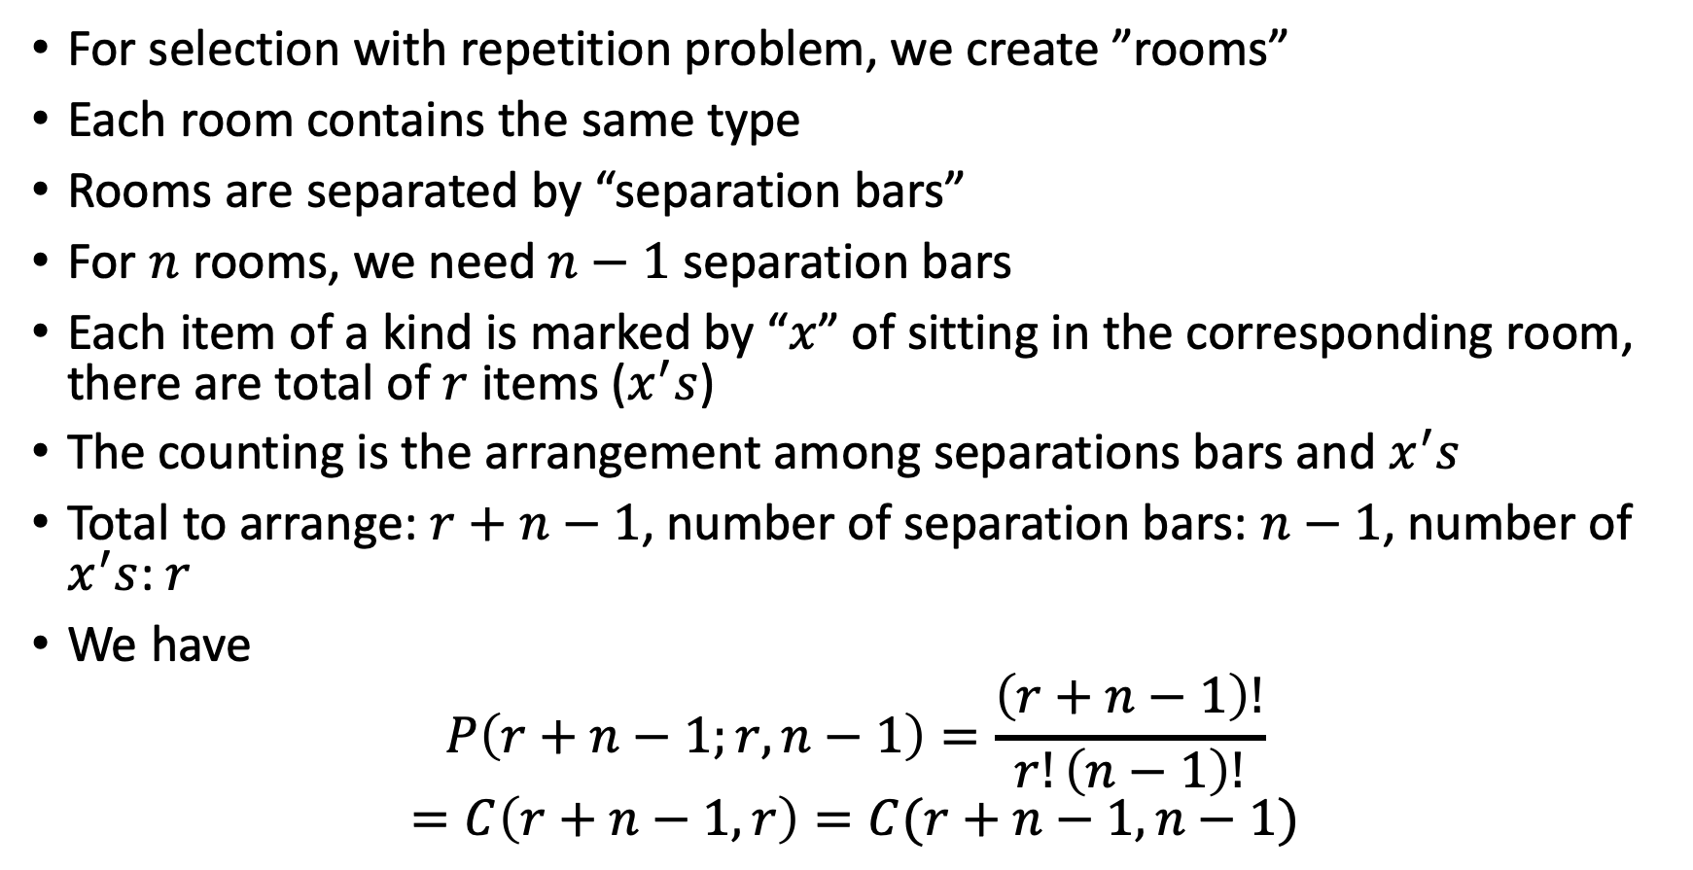
The separation bar method
For selection with repetition problem, we create ”rooms”
Each room contains the same type
Rooms are separated by “separation bars”
For $n$ rooms, we need $n−1$ separation bars
Each item of a kind is marked by “$x$” of sitting in the corresponding room, there are total of $r$ items ($x^{′}s$)
The counting is the arrangement among separations bars and $x^{′}s$
Total to arrange: $r+n−1$, number of separation bars: $n−1$, number of $x^{′}s$: $r$
We have
$$P\left(r+n−1;r, n−1\right)=\frac{\left(r+n−1\right)!}{r!\left(n−1\right)!}$$
$$=C\left(r+n−1,r\right)=C(r+n−1,n−1)$$

Slide 66
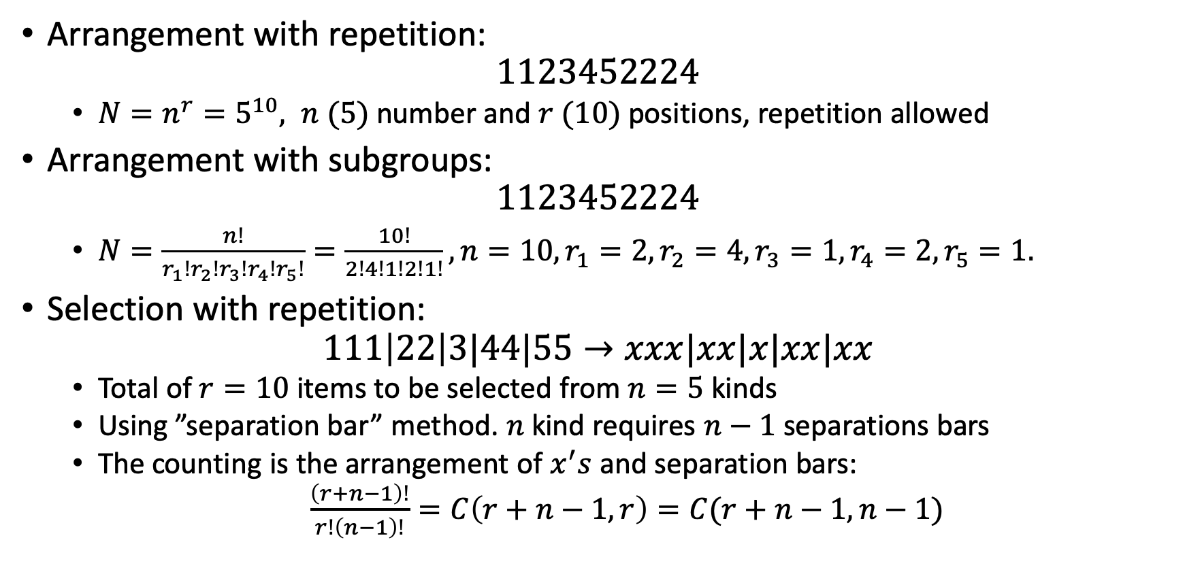
Summary of counting with repetitions
Arrangement with repetition:
$$1123452224$$
$N=n^{r}=5^{10}, n (5)$ number and $r (10)$ positions, repetition allowed
Arrangement with subgroups:
$$1123452224$$
$N=\frac{n!}{r_{1}!r_{2}!r_{3}!r_{4}!r_{5}!}=\frac{10!}{2!4!1!2!1!}, n=10, r_{1}=2, r_{2}=4, r_{3}=1, r_{4}=2, r_{5}=1.$
Selection with repetition:
$$111\left|22\right|3|44|55→xxx|xx|x|xx|xx$$
Total of $r=10$ items to be selected from $n=5$ kinds
Using ”separation bar” method. $n$ kind requires $n−1$ separations bars
The counting is the arrangement of $x^{′}s$ and separation bars:
$\frac{\left(r+n−1\right)!}{r!\left(n−1\right)!}=C\left(r+n−1,r\right)=C(r+n−1,n−1)$

